Slide 1
Pens and Printers Sales Strategy Analysis
An analysis to identify the best strategy to sell the business’ new products effectively

Slide 2


Overview
Project is to identify the best sales strategy to sell the business’ products and help the sales team learn quickly which approach works best and vice versa.
Business Goal
To enable the business’ customers to be more creative and focused on tools for brainstorming.

Slide 3
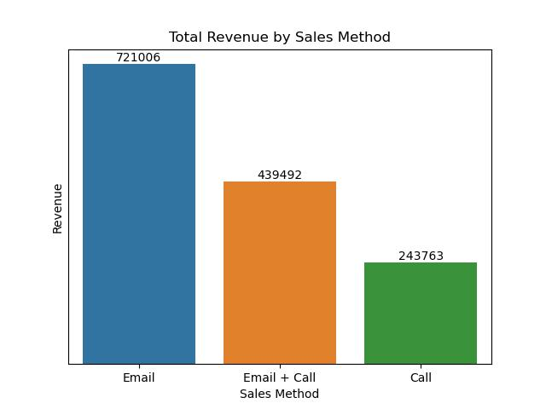
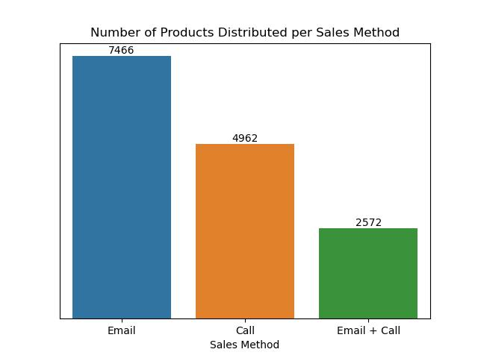
Project Summary
Email sales strategy recorded the highest revenue generated as well as the highest number of products sold.

Slide 4
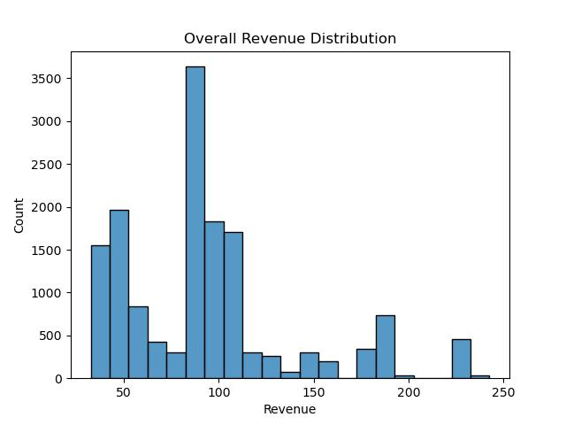
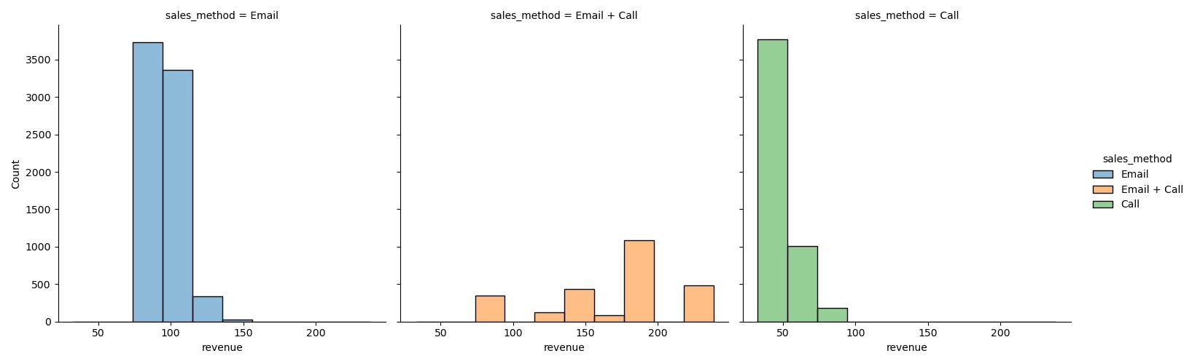
Revenue Spread
Overall distribution of revenue show median between 80 – 100. However, distributing revenue by the different methods show the individual median values.

Slide 5
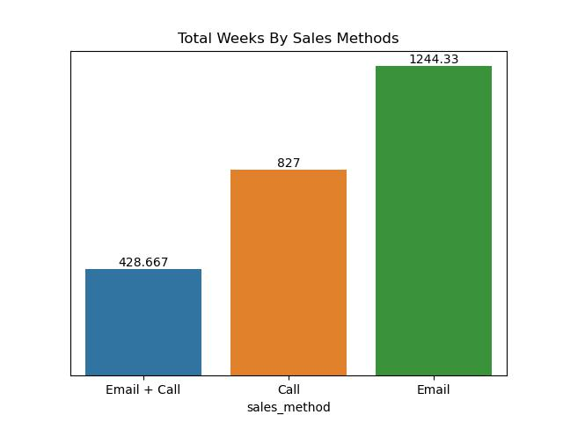
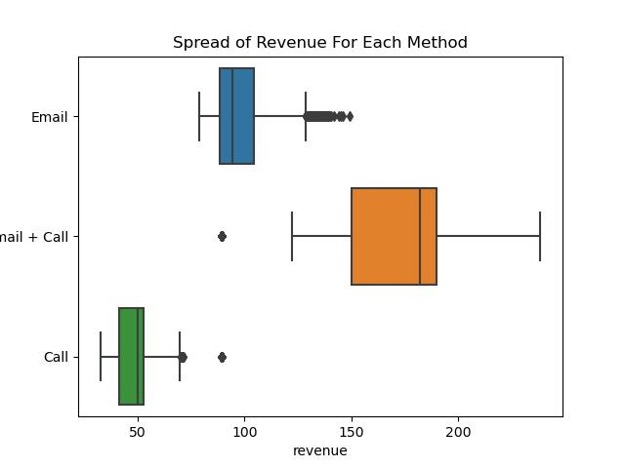
Weeks By Sales Methods vs Revenue By Sales Method

Slide 6
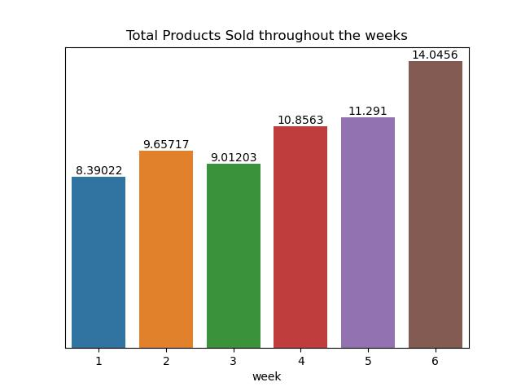
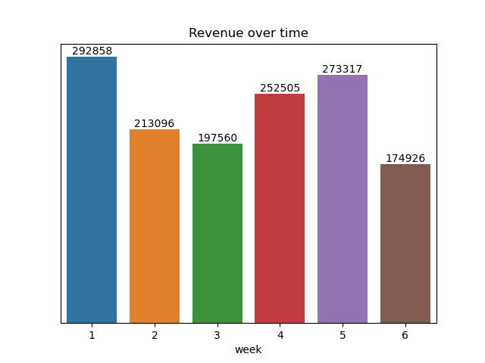
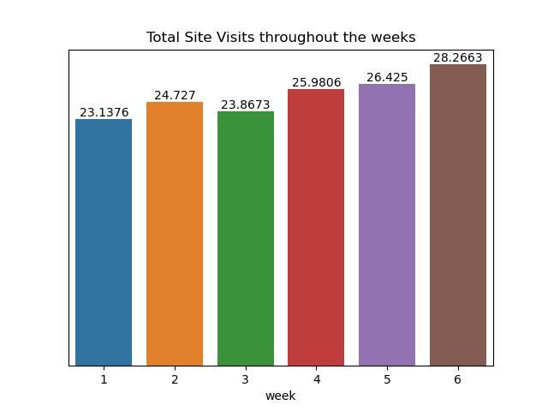
Revenue, Visits and Products Sold Over Time
Revenue is independent of the number of products sold or the number of visits on the website.

Slide 7

Key Findings
Overall, Email generated the most revenue and the greatest number of products sold, but it takes more time from the team to generate revenue which is not the best for the team.
Combination of email and call ranked second in terms of overall revenue generated but when revenue was distributed across individual methods, it turned out to take few weeks to generate revenue. Also, by revenue spread showed the highest median values generated by this strategy.
Call strategy recorded the least revenue generated but recorded fairly high number of products sold compared to the combination of email and call. It also recorded an average number of weeks to generate revenue compared to the other two strategies.

Slide 8
Key Findings cont’
Based on the dataset, one metric to consider based on the dataset is the Customer Engagement Score (CES).
The average CES for the dataset is 24.99.

Slide 9
Recommendations
The best-selling strategy for the team is the combination of email and call as it takes very few weeks to generate more revenue.
The team should also reconsider the prices of these products as they are factors to generate more revenue.

Slide 10
Thank you!

